Slide 1


Slide 2



ABOUT E-XPRO
1.
MOTTO 2025
2.
E-XPRO’s LEADERSHIP
3.
COMMITMENT
Serve Border Crossing
“Leading to serve brands move in Vietnam”
The Bible John C Maxwell Leadership
Serve With Integrity Heart and Excellent Hands
4.
FEATURING
5.
E-XPRO’S SERVICES
6.
CLIENTS
E-XPRO’S SERVICES
Strategy Master Planning
Creative Communication
Good Cost
Quality Commitments
Business & Brand Development Plan and Campaigns
Integrated Marketing
Social Media Marketing (KOCs, KOLs Marketing)
Sustainable Marketing Strategy (CSRs-Build Bridges, Libraries)
Events & Activation
National and International clients
7.
REPRESENTATIVE
E-XPRO’S SERVICES
Director in Vietnam
Ms. NGO NGOC DIEM ELISA

Slide 3



sustainable growing
Since 2017
1
2
3
4
5
6
7
8+
YEAR
2017 Founded
2018
Re-Model
2019–2021
Through Safe Growth Amid Covid
2022
Momentum Growth
2023–2024 3X Growth
2025
Cross-Border Expansion

Slide 4

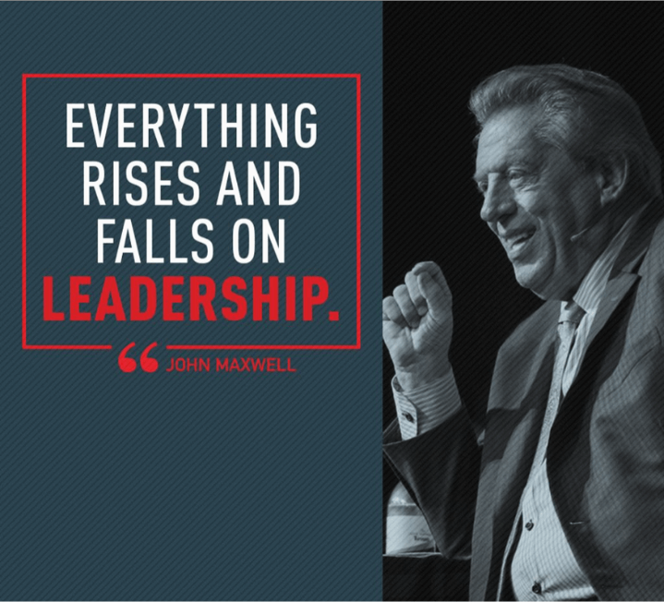
E-XPRO’s LEADERSHIP
E-XPRO’s leadership is founded on the Bible John C Maxwell, which is challenging ourselves to succeed through a two-side coin: The heart and the hand, or inward integrity and outward skills. To have one without the other leads to failure.
Leadership is our vital competence to provide both solutions and it’s standard not only to solve problems in current but to win people’s heart after the problems.

Slide 5

COMMITMENT’s STORY
From the inspiring king of David, E-XPRO found and apply his secret leading his nation successful, that it is written:
And [King of Israel] David shepherded them [his nation] with integrity of heart; with skillful hands he led them
(Book of Psalm 78:72)
SERVE WITH INTERGRITY HEART
AND EXCELLENT HAND
We commit to work with integrity hearts serving people with transparency, consistency, loyalty, an upright heart and disciplined manner.
We compete ourselves stronger in innovating new solutions, ideas, strategies from rich knowledge, understandings, experiences, and market’s insightful problem solver.

Slide 6


Slide 7


Slide 8









SERVICE’S EXPRO
CREATIVE &
STRATEGY
PLANNING
INTERGRATED
MARKETING
COMMUNITY
CARE - CSR
SOCIAL MEDIA
MARKETING
EVENT &
ACTIVATION
Master Planning: Creative Contents apply Brand name, Slogan and Communication message.
Brand Design: Brand’s Iconic, Packaging, Marketing Access online and offline.
Marketing’s Strategy to penetrate market.
Influencer marketing: Engaging with KOCs, KOLs, and endorsers.
Content management: Creating and managing professional content.
Short video production: Crafting high-quality videos to capture attention.
Dealer conferences
(100-500 guests).
Exclusive customer
appreciation parties
(100 guests).
Indoor/outdoor launch
events.
Inspirational trips.
Shopping mall sales
events.
Mall activations.
Dealer store activations.
Roadshows (LED trucks,
bicycles).
Building seven bridges across key provinces: Can Tho, Tien Giang, Soc Trang, Gia Lai, Thanh Hoa, Cao Bang.
Sponsoring education for underprivileged children.
Public Relations
Promotional Sales
Retail Trade Marketing
OOH & Billboards
Radio

Slide 9


Slide 10
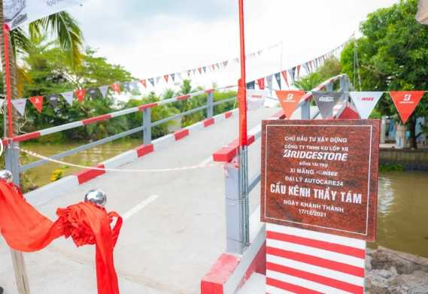
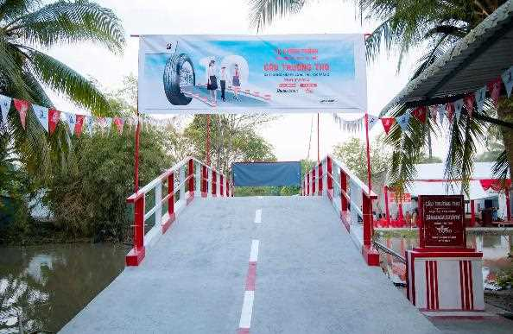
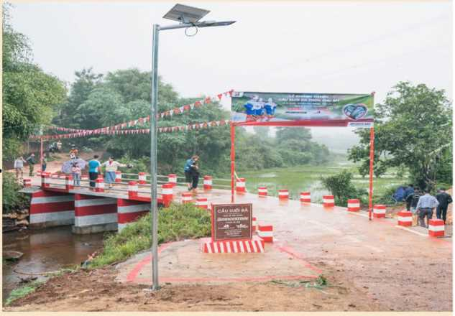
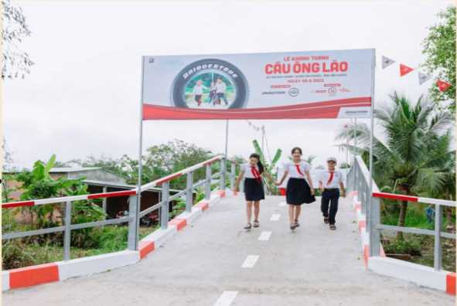
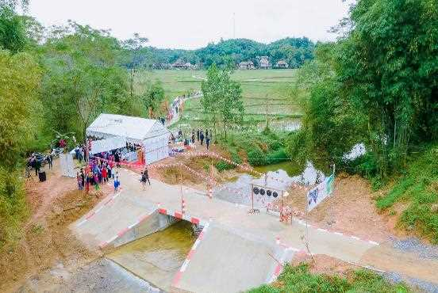
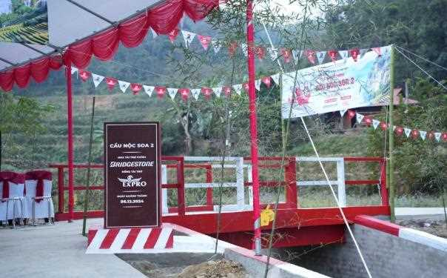
CẦN THƠ CITY
SÓC TRĂNG PROVINCE
GIA LAI PROVINCE
2024
2023
2022
2021
THE PROJECT BUILDING BRIDGE
TIỀN GIANG PROVINCE
THANH HÓA PROVINCE
CAO BẰNG PROVINCE

Slide 11
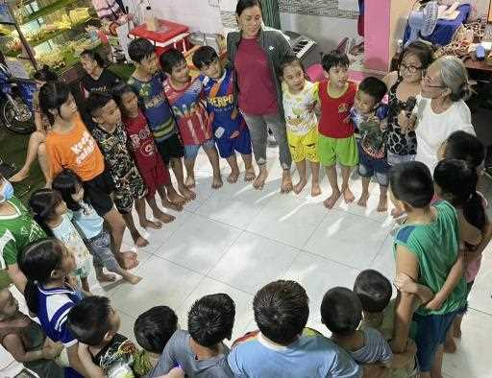
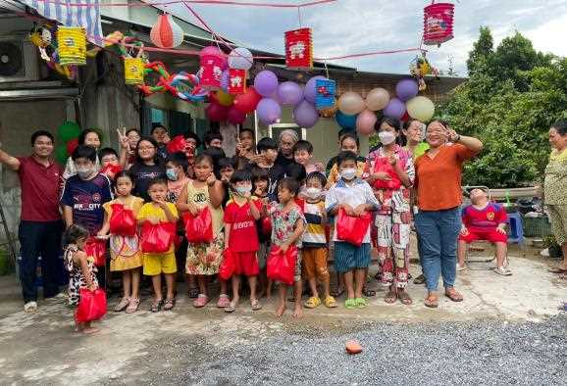
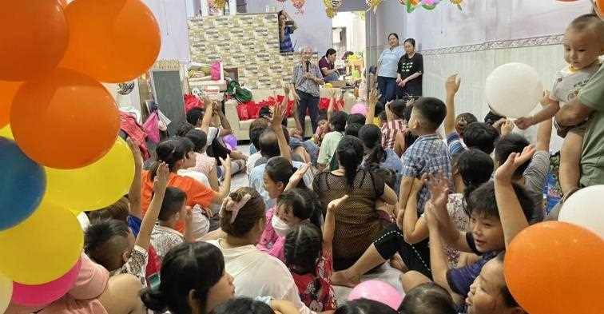


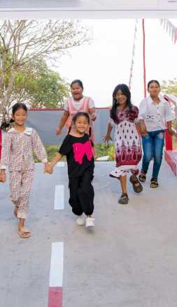
﻿E-XPRO COMMUNITY CHILDCARE MINISTRY
We are willing to contribute to handing over a sustainable world to future generations.
We strongly believe that in order to grow sustainable we need to attach the purpose caring community along our journey.

Slide 12










NAVIGATING THE FUTURE OF CYBERSECURITY WITH AI INNOVATION
Traffic & Leads
Marketing Analytics
New trend to digital strategy
Marketing Strategy, and Trends
Optimise
Digital Production
SMM

Slide 13



E-XPRO is an agency of Western Union in Vietnam set multi marketing activities For Western Union's Tet campaign 2024 and 2025.
2024
2025

Slide 14
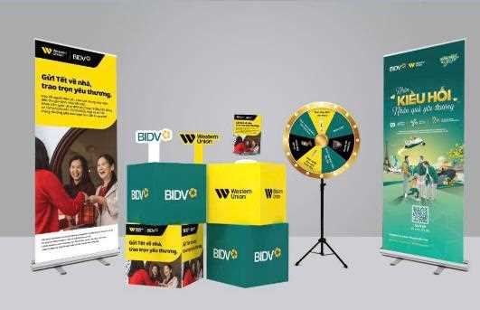
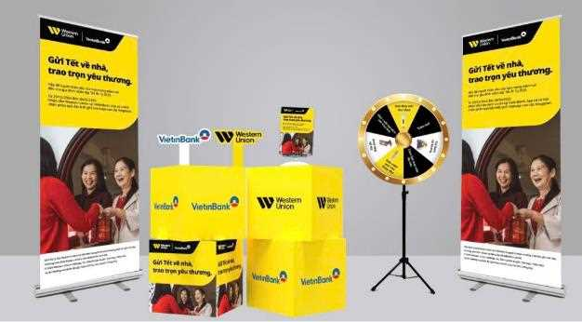

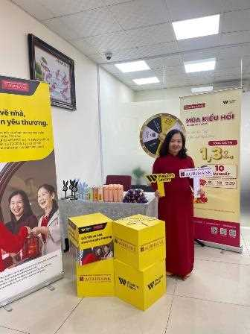
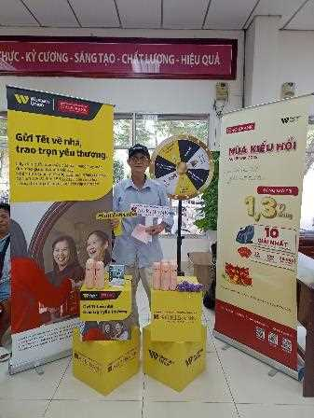
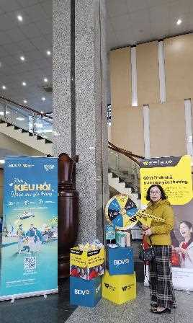
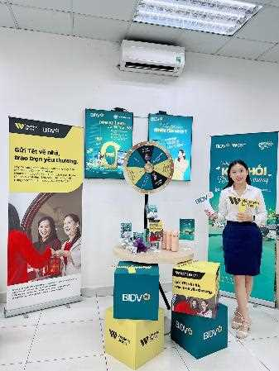
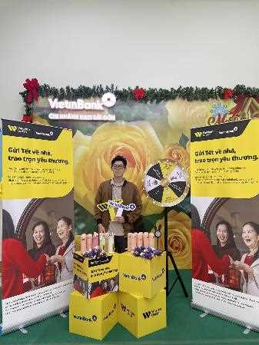
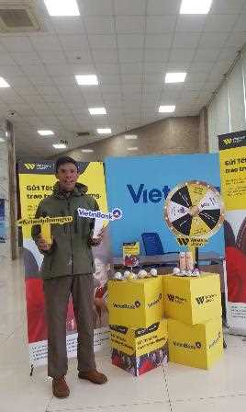
TET CAMPAIGN 2025 | WESTERN UNION x EXPRO | GỬI TẾT VỀ NHÀ – TRAO TRỌN YÊU THƯƠNG
Booth Activation at Banks: Connect from Afar, Receive Gifts Instantly

Slide 15








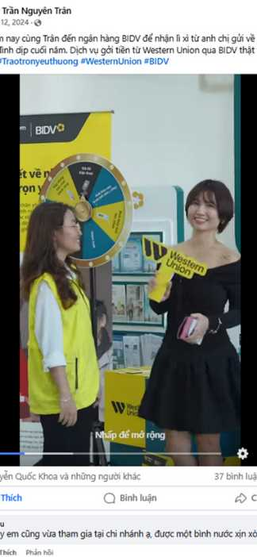
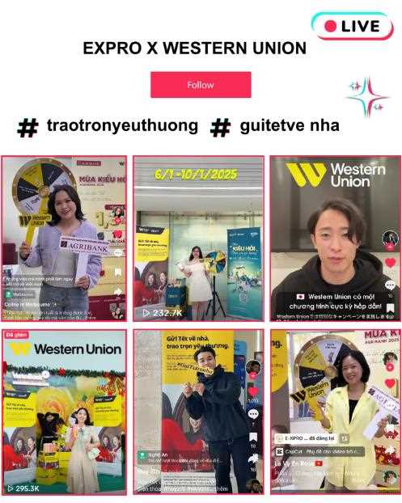











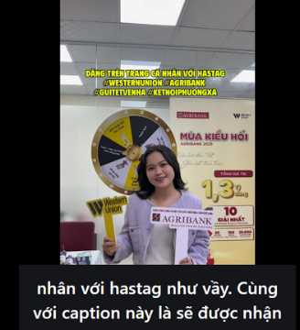



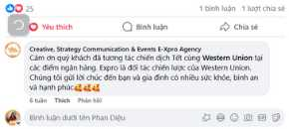





www.9slide.vn
TET CAMPAIGN 2025 | WESTERN UNION x EXPRO | GỬI TẾT VỀ NHÀ – TRAO TRỌN YÊU THƯƠNG
KOLs/KOCs
Bạn bè
Khám phá
Đã follow
Đề xuất

Slide 16




FEATURING BIBLICAL IDEAS & CONCEPT
E-XPRO CREATE THE CONCEPTUAL EVENT “INTERTWIN”: KẾT HỢP TUYỆT HẢO - THỐNG LĨNH MỌI MIỀN
1
THE IDEA COMES FROM THE HISTORICAL STORY OF VIETNAM
Le Loi & Nguyen Trai and the victory of the Lam Son uprising
2
SHOW THE STRONG SPIRIT OF THE NEW PRODUCT
3
CREATE SALES TEAM CONFIDENCE TO WIN
Notes:
Những nội dung chỉnh sửa:
Bổ sung logo nhãn hàng: NESCAFE
Cách trình bày slide này: có thể tham khảo tương tự như slide số 14,15,16,17
Nội dung cần hiển thị
E-XPRO CREATE THE CONCEPTUAL EVENT - INTERTWIN: KẾT HỢP TUYỆT HẢO - THỐNG LĨNH MỌI MIỀN
1. The idea comes from the historical story of Vietnam: Le Loi & Nguyen Trai and the victory of the Lam Son uprising
2. Show the strong spirit of the new product
3. Create sales team confidence to win

Slide 17


FEATURING BIBLICAL IDEAS & CONCEPT
E-XPRO CREATE & DEVELOP NEW PRODUCT’S IDENTITY:
Key visual, iconic, and communication tagline “holdfast till it done”.
Bible Sources: A Crown of Life, book James 1:12
1
2
3
EXPLOITING THE SPECIAL FACTORS THAT MAKE THE PRODUCT DIFFERENT:
”HOLDFAST”
POSITIONING DIFFERENT & PREMIUM PRODUCTS IN THE MARKET
SHOWING THE UNIQUE SELLING POINT OF THE PRODUCT THROUGH THE MESSAGE AND KEY VISUAL
Notes:
Nội dung chỉnh sửa:
Cách trình bày slide này: có thể tham khảo tương tự như slide số 14,15,16,17
Thêm logo Sumitomo Chemical
Nội dung hiển thị
E-XPRO CREATE & DEVELOP NEW PRODUCT’S IDENTITY: KEY VISUAL, ICONIC, AND TAGLINE
Exploiting the special factors that make the product different: “Holdfast till its weed finished”
Positioning different & premium products in the market
Showing the unique selling point of the product through the message and key visual

Slide 18

FEATURING BIBLICAL IDEAS & CONCEPT
E-XPRO'S CREATIVE STORY AND
BRAND DEVELOPMENT
Solution to Sumitomo relaunch products
1
2
3
CREATIVE COMMUNICATION CONTENT & VISUAL
INTRIGUING TO TARGETS
PRODUCT LIFETIME VALUES
Visual accomplishes many objectives
Metaphor the elephant's trunk to spray, safety challenged
“PROGIBB PHUN LÀ PHẤT”
“USE AND PROSPER”

Slide 19


FEATURING BIBLICAL IDEAS & CONCEPT
“SUPERIO SIX WINGS ANGEL”
BRAND COMMUNICATION
BIBLICAL CREATIVE STORY: Bible book Isaiah 6:2-3 – (SUPERIOR ANGELS)
"2 Above it stood the as Seraphims: each one had six wings; with twain he covered his face, and with twain he covered his feet, and with twain he did fly. 3 And one cried unto another, and said, Holy, holy, holy, is the Lord of hosts: the whole earth is full of his glory”
(ISAIAH 6:2-3 )

Slide 20
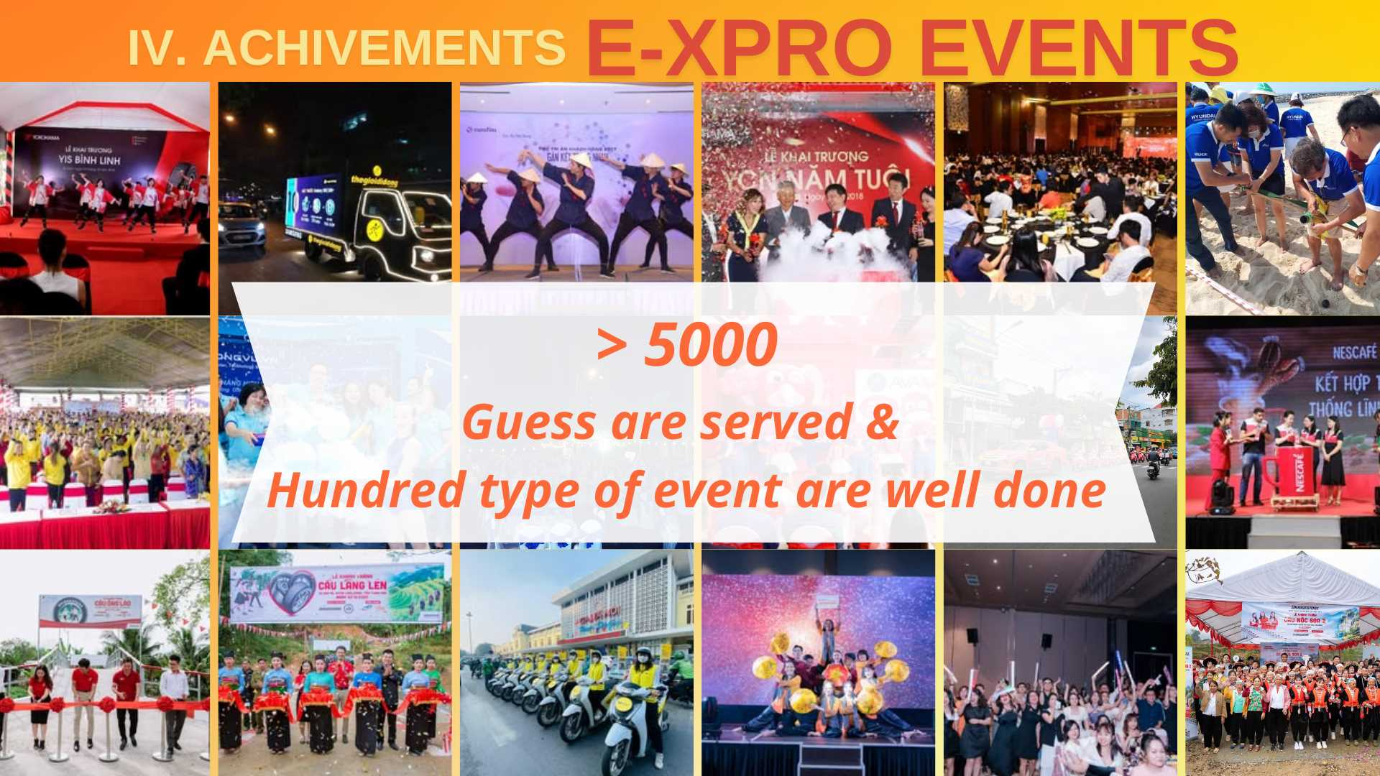
E-XPRO EVENTS

Slide 21


FEATURING BIBLICAL IDEAS & CONCEPT
E-XPRO CREATIVE THE CONCEPTUAL FOR YEAR END PARTY:
“UNSTOPPABLE FOR MORE”
1
The message was inspired by Caleb with the famous quote: GIVE ME THIS MOUTAIN
(Biblical book Joshua 14:6-15)
2
Uplift & motivate the staff take after the spirit from Caleb, always strive to create greater victories and achievements ahead

Slide 22

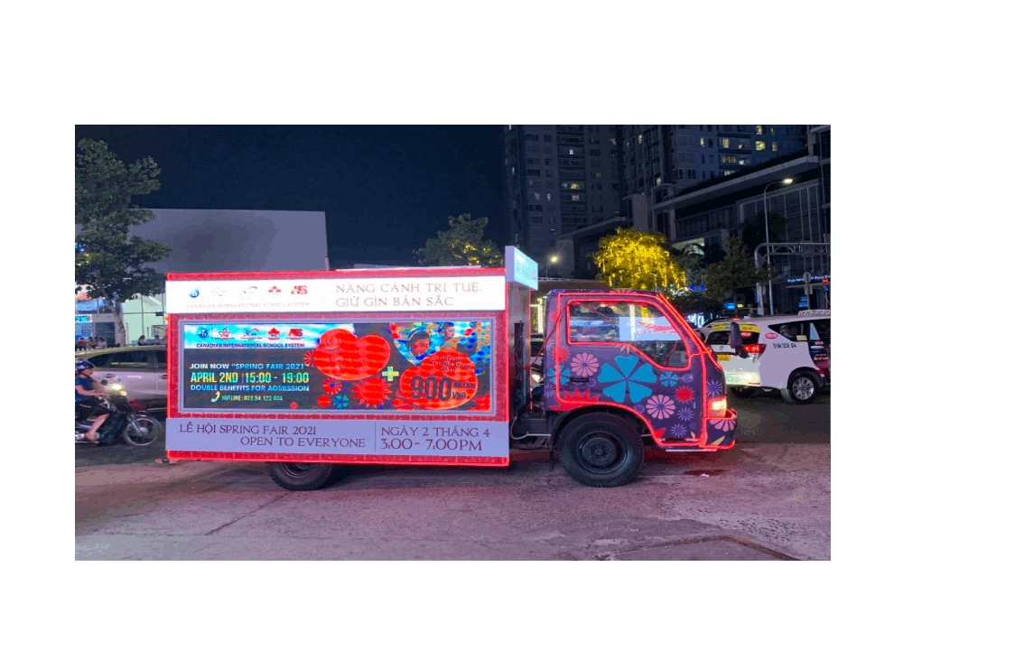
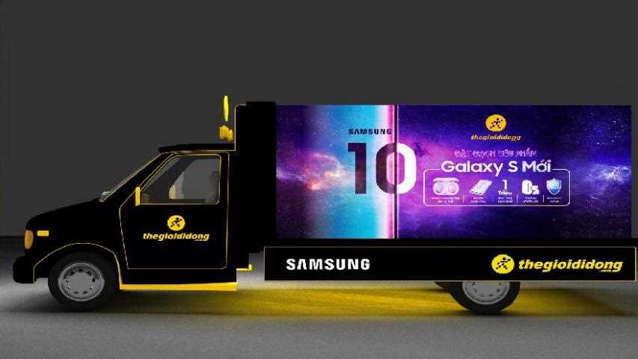
Those are two project help marketing community aware of E-XPRO since 2019
LAUNCHING SAMSUNG
GALAXY S10 2019 | LED TRUCK
CISS
SPRING FAIR | LED TRUCK
E-XPRO INNOVATION AND ABUNDANTLY KPIS EARNED:
Brand's visibilities
Brand's attractions
Social discussions
Event-attract to 1.000 peoples within 2 days doing activation

Slide 23
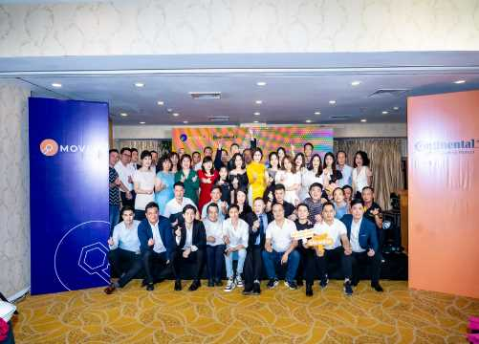
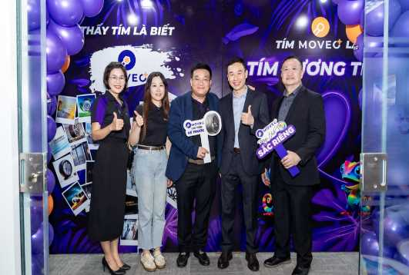
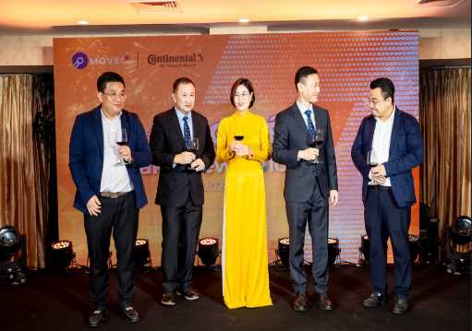
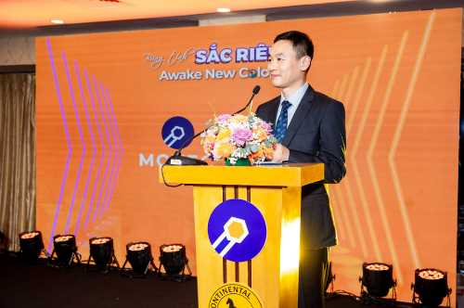
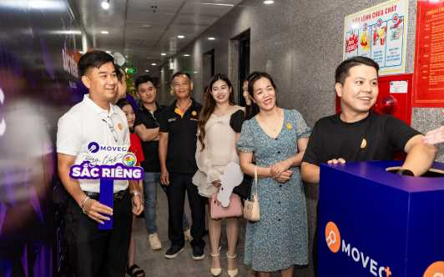
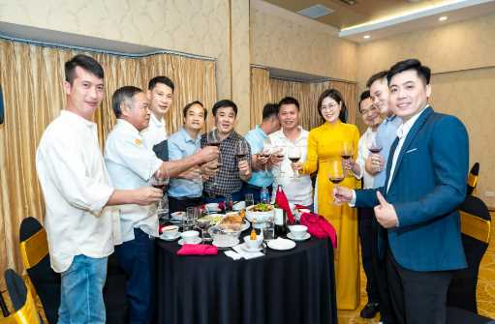
CLIENT: MOVEO ⁺ & CONTINENTAL TIRES.
LOCATION: HÀ NỘI 2 DAYS

Slide 24
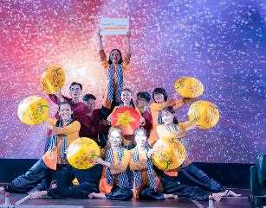
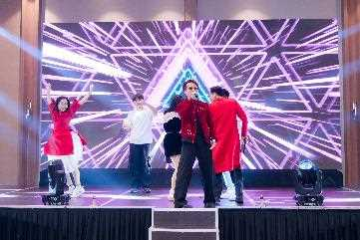
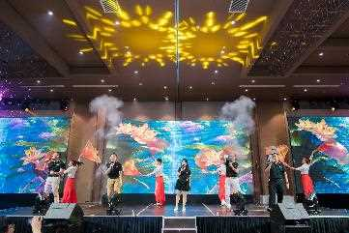

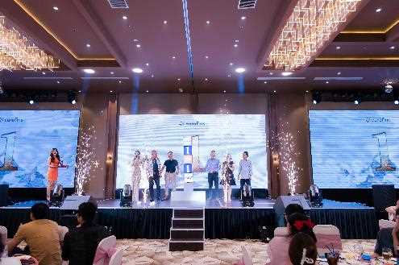
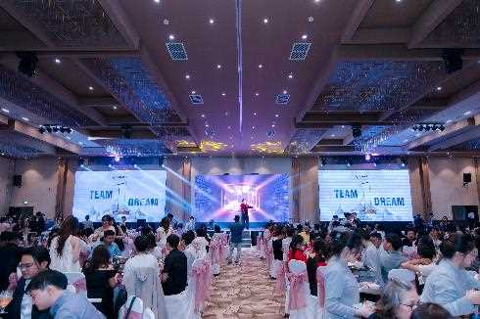
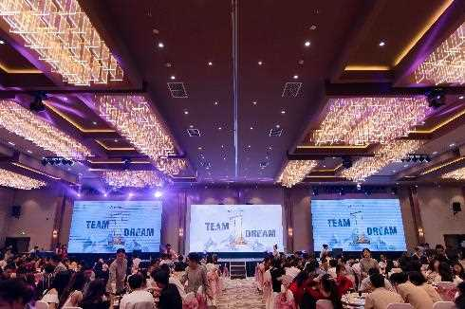
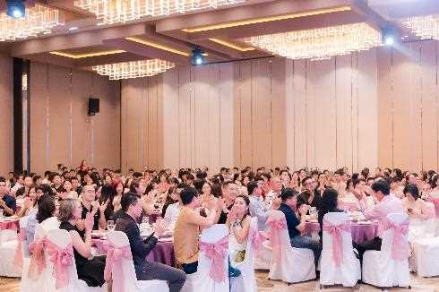
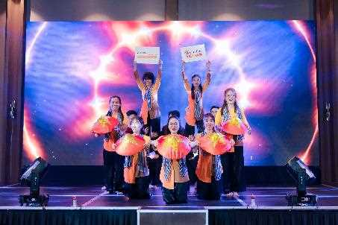
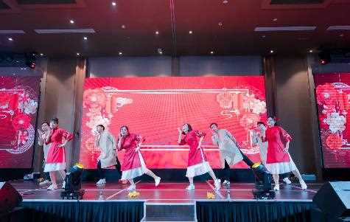
EVENTS & ACTIVATION

Slide 25

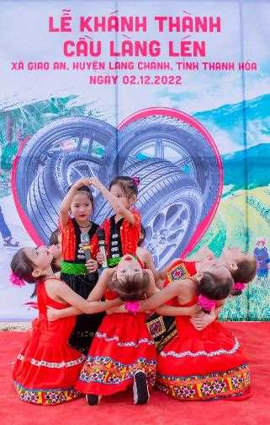
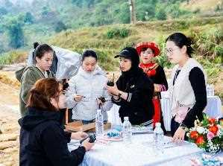
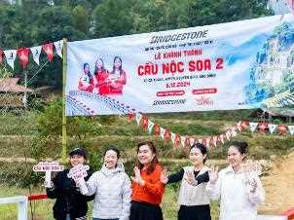
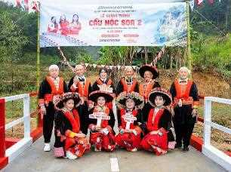

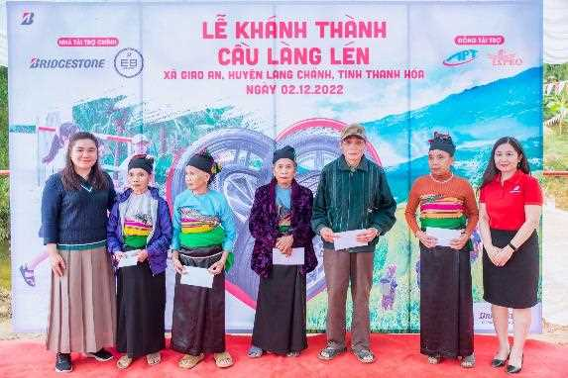
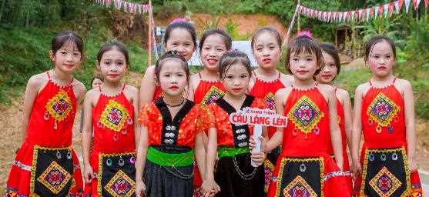
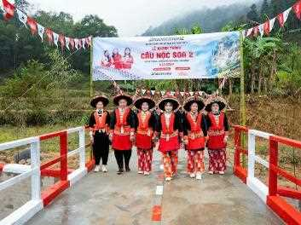
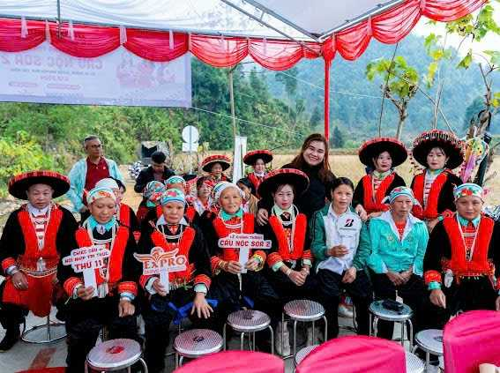


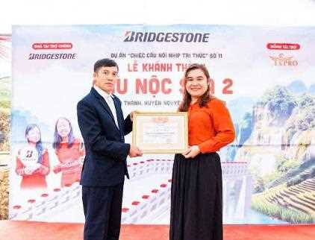
1. LOCATION RESEARCH & BRIDGE CONSTRUCTION MANAGEMENT
2. INAUGURATING THE 7TH BRIDGE IN CAO BANG
3. EXPLOITING AND PROMOTING THE CULTURAL IDENTITIES OF ETHNIC MINORITIES
Notes:
Bổ sung nội dung bằng Tiếng Anh: (Thay cho chỗ “Thanh Hóa”
Triển khai tìm kiếm vị trí, thực hiện công tác quản lý công trình xây dựng cây cầu
Tổ chức lễ khánh thành cho cây cầu thứ 8 tại vùng núi cao Thanh Hóa
Khai thác và quảng bá những bản sắc văn hóa của người dân tộc thiểu số

Slide 26










05 CONSECUTIVE YEAR:
YEAR END PARTY FOR NEARLY 300 GUESTS
UNSTOPPABLE FOR MORE

Slide 27








BIGGEST LAUNCHING 2022
NEW PRODUCT NESCAFÉ 3IN1
Hồ Chí Minh
Cần Thơ
Đà Nẵng
Hà Nội

Slide 28













50ᵗʰ SHOP KICK-OFF EVENT
700 GUESTS OUTDOOR

Slide 29












50ᵗʰ SHOP KICK-OFF EVENT
& ROADSHOWS

Slide 30

FESTIVAL FROM 1.000 PEOPLE
NEW PRODUCT LAUNCH + DEALER’S PROMOTION DAY

Slide 31

SPCIAL GUEST: ERIC NAM - CELEBRITY IN KOREA

Slide 32






E-XPRO
ACTIVATIONS
SERVE NATIONWIDE
Mekong Dalta, the Southeast, Central, the North, HCM
DEVERSIFIED
Shop Activations, Booth Decors, OOH, Roadshows, POSM

Slide 33

SERVED FROM NATIONWIDE TO INTERNATIONAL

Slide 34


DIVERSIFIED TYPES OF ACTIVATION
ROADSHOWS | ACTIVITIES | SHOP PROMOTION
WESTERN UNION - BIKE ACTIVATION
Ninh Kiều – Cần Thơ

Slide 35

MEKONG DELTA | CENTRAL | THE NORTH

Slide 36



















4 CITIES DEALER’S PROMOTION ACTIVATIONS DURING N-COVID

Slide 37




Slide 38







Slide 39






Slide 40


E-XPRO’s man working with manner of serving, seeking the best for our clients, staffs, and community.
By obeying our Christian laws
We commit our heart with integrity, transparency,
consistency, loyalty, and upright manner to the people.
Also, with the excellent hands that compete ourselves stronger in innovating new solution, ideas, strategies from knowledges, understandings, experiences and market’s insightful problem solver.
E-XPRO is thankful for any meet and cooperation with clients, staffs, vendors, providers.
May our God bless you in return from your blessings to us.
Shalom!
Representative Director in Vietnam
MS. NGO NGOC DIEM ELISA

Slide 41


